Slide 1
Machine Learning DSE 2254
Rohini R. Rao & Manjunath Hegde
Department of Data Science and Computer Applications
MIT, Manipal
March 2022
Slide - Set 2 – Regression Models

Slide 2
Supervised Learning Regression - Prediction

Slide 3
Supervised Learning Regression - Classification

Slide 4
Notations

Slide 5
Terminology
Feature Space represents the data in a set of n features
Features are properties that describe each instance in Instance space
Multiple features represented in a Feature Vector
We are given data and induction identifies a function, which can explain the data.
Hypothesis could be a function which is a line or curve which separates classes.
Hypothesis Space
is the set of all legal functions that are solutions to the task
Comprises of the features chosen and the language or the class of functions

Slide 6
Terminology

Slide 7
Hypothesis language - representations

Slide 8
Regression Analysis
Parametric Model
Is a form of predictive modelling technique which investigates the relationship between
a dependent (target)
independent variable (s) (predictor).
Used for forecasting, time series modelling and finding the causal effect relationship between the variables
fit a curve / line to the data points, so that the differences between the distances of data points from the curve or line is minimized.

Slide 9
Type of Regression Models

Slide 10
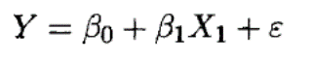
Some fits to the data : which is best?
Linear Model : y = Constant
Cubic Function
9th Degree Polynomial

Slide 11
Hypothesis

Slide 12
Hypothesis

Slide 13
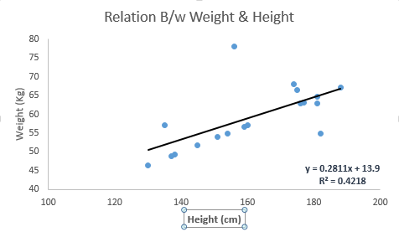
Linear Regression
There must be linear relationship between independent and dependent variables
Relationship as a best fit line
we can assume that there is some noise in the data which causes Random error Ɛ
Error is normally distributed with mean 0, and standard deviations σ
Called as Gaussian noise or white noise
To get best fit line use Least Square Method
It calculates the best-fit line for the observed data by minimizing the sum of the squares of the vertical deviations from each data point to the line.
Linear Regression is very sensitive to Outliers.
Assumptions
there is very little or no multi-collinearity in the data.
There is very little or no auto-correlation in the error terms.
The error terms must possess constant variance.

Slide 14
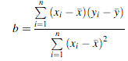
Simple Linear Regression
Mathematical model that predicts continuous response variable
Where there appears to be a linear relationship between two variables
The prediction model is an equation of a straight line
Method of Least squares
Θ₁
Θ₀= - Θ₁

Slide 15
Example 2
X^{(i)} | Y^{(i)} | h(x) | (h(x)-Y^{(i)})
2 | 69
9 | 98
5 | 82
5 | 77
3 | 71
7 | 84
1 | 55
8 | 94
6 | 84
2 | 64

Slide 16
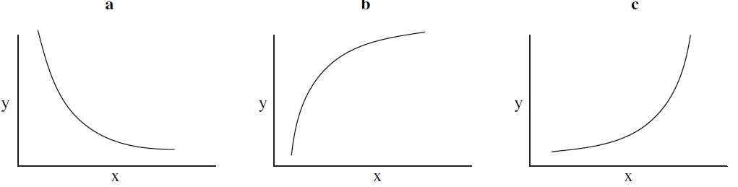
Simple non-linear regression
transform the nonlinear relationship to a linear relationship using a mathematical transformation
Situation a: Transformations on the x, y or both x and y variables such as log or square root.
Situation b: Transformation on the x variable such as square root, log or -1/x.
Situation c: Transformation on the y variable such as square root, log or -1/y.

Slide 17
Example 2 – Simple Non Linear Regression

Slide 18
Cost Function

Slide 19
Cost Function

Slide 20
Contour Plot

Slide 21
Gradient Descent

Slide 23
Relevant Terminology
Multicollinearity
When the independent variables are highly correlated to each other, then variables are said to possess multicollinearity.
It makes task complex in selecting the important featured variables.
can increase the variance of the coefficient estimates and make the estimates very sensitive to minor changes in the model.
Autocorrelation
Presence of correlation in error terms
refers to the degree of correlation between the values of the same variables across different observations in the data.
Outliers
In every dataset, there must be some data points that have low or high value as compared to other data points
those data points don’t relate to the population termed as outliers, an extreme value.
Heteroscedasticity
systematic change in the spread of the residuals over the range of measured values.
The error terms must possess constant variance.
Absence of constant variance leads to heteroskedestacity.

Slide 24
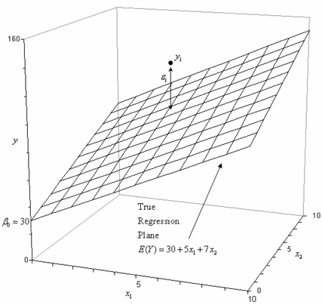
Multiple Linear Regression
Suffers from
Multicollinearity, autocorrelation, heteroskedasticity.
Multicollinearity can increase the variance of the coefficient estimates and make the estimates very sensitive to minor changes in the model.
In case of multiple independent variables, we can go with step wise approach for selection of most significant independent variables.

Slide 25
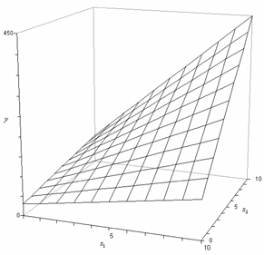
Polynomial Regression
the relationship between the independent variable x and the dependent variable y is modelled as an nth degree polynomial in x.
is considered to be a special case of multiple linear regression.
contain squared and higher order terms of the predictor variables making the response surface curvilinear.

Slide 26
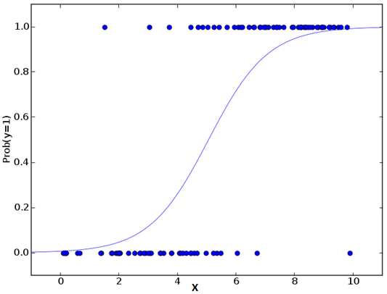
Logistic Regression
The nature of target or dependent variable is dichotomous, which means there would be only two possible classes.
doesn’t require linear relationship between dependent and independent variables.
Types include
Binomial
Multinomial
represent “Type A” or “Type B” or “Type C”.
Ordinal
represent “poor” or “good”, “very good”,
Is used to find the probability of event=Success and event=Failure.
y = e^(b0 + b1*x) / (1 + e^(b0 + b1*x))
the parameters are chosen to maximize the likelihood of observing the sample values rather than minimizing the sum of squared errors
Assumption:
The independent variables should not be correlated with each other i.e. no multi collinearity.

Slide 27
Stepwise Regression
The aim is to maximize the prediction power with minimum number of predictor variables.
While dealing with multiple independent variables, fits the regression model by adding/dropping co-variates one at a time based on a specified criterion.
The selection of independent variables is done with the help of an automatic process, which involves no human intervention.
This feat is achieved by observing statistical values like R-square, t-stats and AIC metric to discern significant variables.
Stepwise regression methods are :
Forward selection starts with most significant predictor in the model and adds variable for each step.
Backward elimination starts with all predictors in the model and removes the least significant variable for each step.

Slide 28
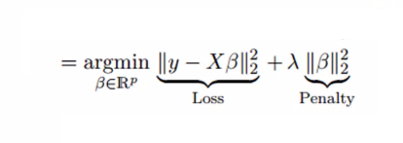
Ridge Regression
when the data suffers from multicollinearity (independent variables are highly correlated).
we not only minimize the sum of squared residuals but also penalize the size of parameter estimates, in order to shrink them towards zero:
By adding a degree of bias to the regression estimates, ridge regression reduces the standard errors.
Above, we saw the equation for linear regression. :
y=a+b*x+e
[error term is the value needed to correct for a prediction error between the observed and predicted value]
=> y= a+ b₁x₁+ b₂x₂+....+e, for multiple independent variables.
Solves the multicollinearity problem through shrinkage parameter λ (lambda)
The coefficients of correlated predictors are similar

Slide 29
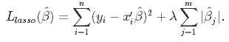
Lasso Regression
Least Absolute Shrinkage and Selection Operator
Penalizes the absolute size of the regression coefficients.
If group of predictors are highly correlated, lasso picks only one of them and shrinks the others to zero which certainly helps in feature selection
one of the correlated predictors has a larger coefficient, while the rest are (nearly) zeroed.
it reduces the variability and improving the accuracy of linear regression models.

Slide 30
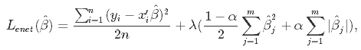
Elastic Net Regression
hybrid of Lasso and Ridge Regression techniques.
It is trained with L1 and L2 prior as regularizer.
It is recommended to use when the number of predictors is very much higher than the number of observations.
is useful when there are multiple features which are correlated.
Lasso is likely to pick one of these at random, while elastic-net is likely to pick both.
It encourages group effect in case of highly correlated variables
There are no limitations on the number of selected variables
where α is the mixing parameter between ridge (α = 0) and lasso (α = 1).

Slide 31
Supervised Learning Regression - Classification

Slide 32
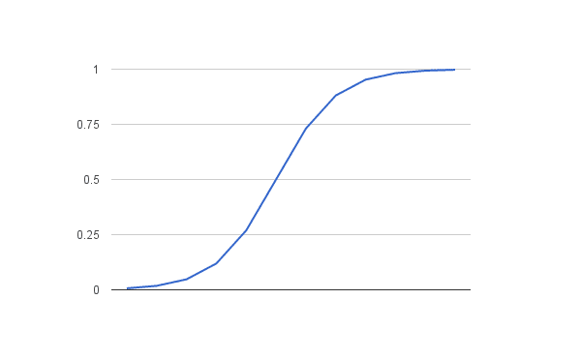
Logistic Function
The logistic function is defined as: transformed = 1 / (1 + e^-x)
X | Transformed y
-5
-4
-3
-2
-1
0
1
2
3
4
5

Slide 33
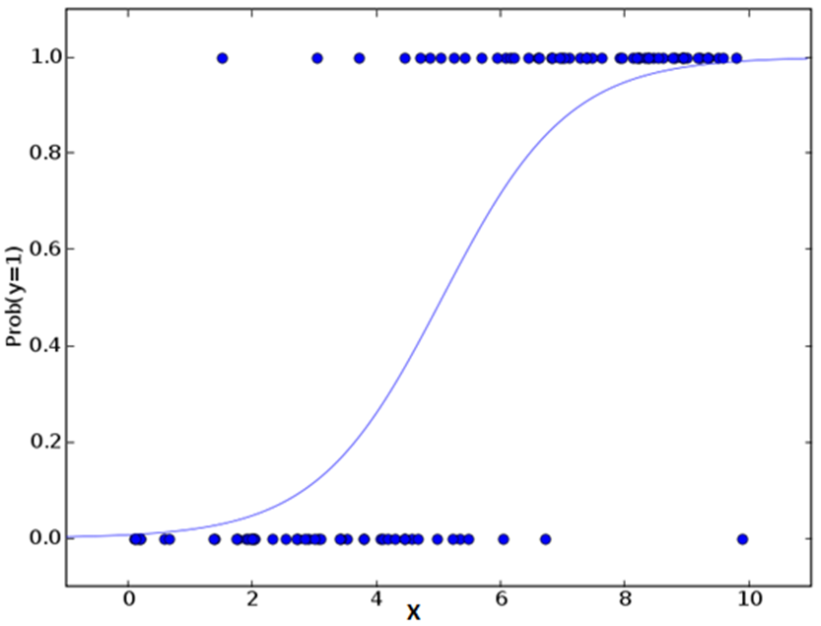
Logistic Regression
Classification
Email – Spam/Not Spam
Tumor –is Malignant/Benign
y Ɛ {1,0} - 1 is positive class and 0 is negative class
Can be extended to y Ɛ {0,1,2,3}
Threshold classifier output h_{Ɵ}(x) at 0.5
If h_{Ɵ}(x) >= 0.5 then y = 1
If h_{Ɵ}(x) < 0.5 then y = 0
Logistic Regression :
0 <= h_{Ɵ}(x) <= 1

Slide 34

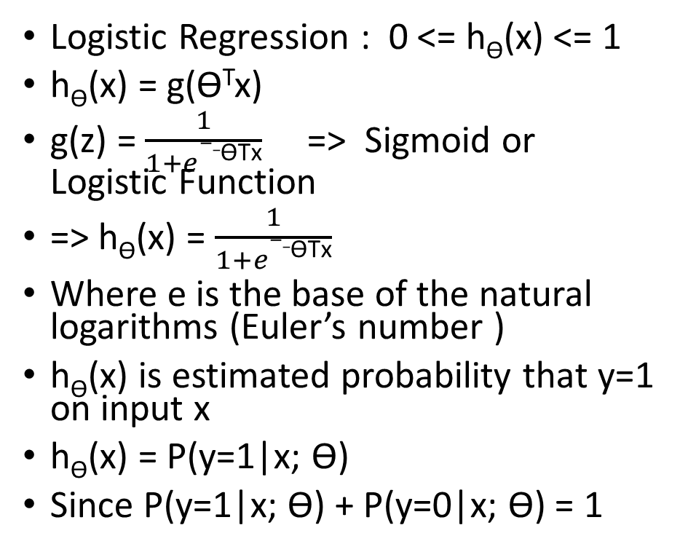
Logistic Regression Model
Logistic Regression : 0 <= h_{Ɵ}(x) <= 1
h_{Ɵ}(x) = g(Ɵ^{T}x)
g(z) = $\frac{1}{1+e−_\text{Ɵ}\text{Tx}}$ => Sigmoid or Logistic Function
=> h_{Ɵ}(x) = $\frac{1}{1+e−_\text{Ɵ}\text{Tx}}$
Where e is the base of the natural logarithms (Euler’s number )
h_{Ɵ}(x) is estimated probability that y=1 on input x
h_{Ɵ}(x) = P(y=1|x; Ɵ)
Since P(y=1|x; Ɵ) + P(y=0|x; Ɵ) = 1

Slide 35
Logistic Regression – Decision Boundary
Prob(y=1)
If h_{Ɵ}(x) >= 0.5, Ɵ^{T}X >=0
Prob(y=0)
If h_{Ɵ}(x) < 0.5, Ɵ^{T}X < 0

Slide 36
Logistic Regression – Decision Boundary
If Ɵ^{T} is [-3 , 1, 1]
Decision Boundary
x₁ + x₂ > = 3

Slide 37
Logistic Regression – Non Linear Boundaries
If Ɵ^{T} is [-1 , 0, 0, 1, 1]

Slide 38
Logistic Regression - Non-linear boundaries

Slide 40
Logistic Regression - Example
Consider the following data set which predicts whether a customer is a ‘Loan Non-Defaulter’ based on the ‘Amount of Savings (in Lakhs)’. The logistic regression analysis on the training data set gave the following output.
The coefficients are β₀= -4.07778 and β₁= 1.5046.
For the following test data set predict the class label using Logistic Regression
Compute the Confusion Matrix of the Classifier Model and comment on the Performance.
Savings (in Lakhs) | 0.5 | 0.85 | 1 | 1.25 | 1.75 | 1.75 | 2.25 | 3.25 | 4.25 | 5
Non-Defaulter | 0 | 0 | 0 | 0 | 0 | 1 | 1 | 1 | 1 | 1

Slide 41
Logistic Regression - Example
Savings (in Lakhs) | 0.5 | 0.85 | 1 | 1.25 | 1.75 | 1.75 | 2.25 | 3.25 | 4.25 | 5
Non-Defaulter (Actual) | 0 | 0 | 0 | 0 | 0 | 1 | 1 | 1 | 1 | 1
(Predicted)

Slide 42
Logistic Regression – Cost function

Slide 43
Logistic Regression – Cost function

Slide 44
Logistic Regression – Cost function

Slide 45
Multiclass Classification

Slide 46
Multi class Classification

Slide 47
Logistic Regression - Prediction
X1 | X2 | Actual Y | Output (b0+b1*x1 + b2* x2) | Predicted Y
2.7810 | 2.5505 | 0
1.4654 | 2.3621 | 0
3.3965 | 4.4002 | 0
1.3880 | 1.8502 | 0
3.0640 | 3.0053 | 0
7.6275 | 2.7592 | 1
5.3324 | 2.0886 | 1
6.9225 | 1.7710 | 1
8.6754 | -0.2420 | 1
7.6737 | 3.508 | 1
b0 = -0.4066054641
b1 = 0.8525733164
b2 = -1.104746259
What is the
Accuracy?

Slide 48
Gradient Descent

Slide 49
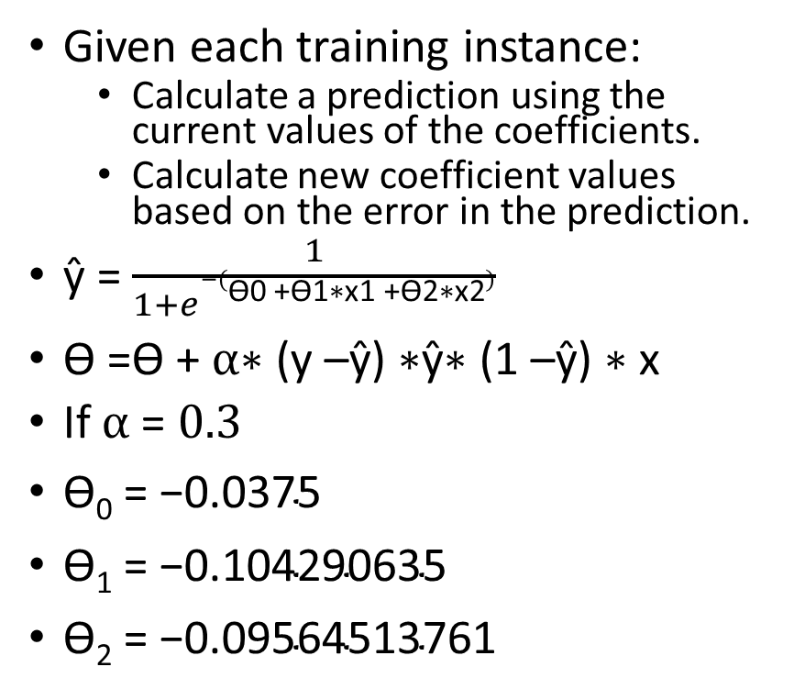
Logistic Regression by Stochastic Gradient Descent
Given each training instance:
Calculate a prediction using the current values of the coefficients.
Calculate new coefficient values based on the error in the prediction.
ŷ = $\frac{1}{1+e−(\text{Ɵ}\text{0 +Ɵ1∗}\text{x}\text{1 +Ɵ2∗}\text{x}\text{2})}$
$\text{Ɵ =Ɵ + }α\text{∗ (}\text{y}\text{ –}\text{ŷ}\text{) ∗}\text{ŷ}\text{∗ (1 –}\text{ŷ}\text{) ∗ }\text{x}$
If $α$ = $0.3$
$\text{Ɵ}\text{0}\text{ = −0.0375}$
$\text{Ɵ}\text{1}\text{ = −0.104290635}$
$\text{Ɵ}\text{2}\text{ = −0.09564513761}$
X1 X2 Y
2.7810836 2.550537003 0
1.465489372 2.362125076 0
3.396561688 4.400293529 0
1.38807019 1.850220317 0
3.06407232 3.005305973 0
7.627531214 2.759262235 1
5.332441248 2.088626775 1
6.922596716 1.77106367 1
8.675418651 -0.2420686549 1
7.673756466 3.508563011 1

Slide 50
Over fitting in Linear Regression
Underfit – High Bias Just Right Overfit – High Variance

Slide 51
Over fitting in Logistic Regression
Underfit – High Bias Just Right Overfit – High Variance

Slide 52
Addressing Over fitting
Options
Reduce the number of features
Manually select which features to keep
Model Selection Algorithms
Regularization
Keep all features but reduce the magnitude/values of parameter ƟJ
Works well if many features all of which contribute a little to the predicting y

Slide 53
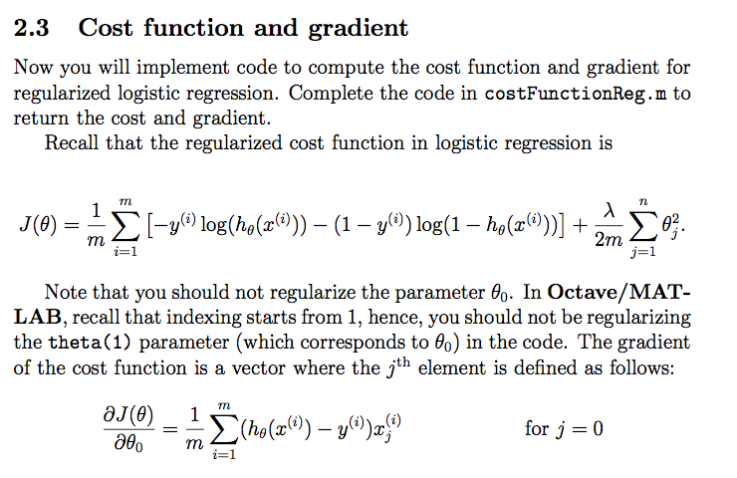
Regularization
Linear Regression
Logistic Regression Cost Function
Regularised Cost function

Slide 54
Eager Vs. Lazy Learners
Eager learners
when given a set of training tuples, will construct a classification model before receiving test tuples to classify.
Example: Regression Models
Lazy learner
simply stores it and waits until it is given a test tuple. Only when it sees the test tuple does it perform generalization to classify the tuple based on its similarity to the stored training tuples.
are also referred to as instance-based learners, even though all learning is essentially based on instances.
Can be computationally expensive , not suited for real time decisions
Lazy learners, however, naturally support incremental learning.
Example : k-nearest neighbor, Bayesian Classifiers

Slide 55
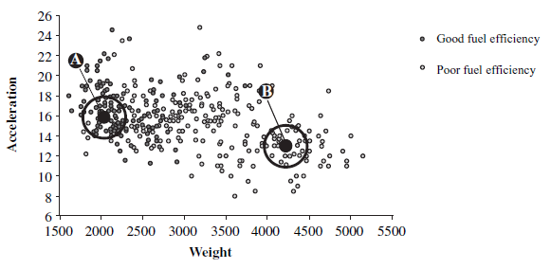
Visualization of k-nearest neighbors

Slide 56
K-Nearest Neighbors
Training tuples are described by n attributes and each tuple represents a point in n dim space.
Learning by analogy - By comparing a given test tuple with training tuples that are similar to it by defining its neighborhood in terms of “k”.
Classifier searches the pattern space for the k training tuples that are closest to the unknown tuple.
For k-nearest-neighbor classification , the unknown tuple is assigned the most common class among its k nearest neighbors.
Distance measures could be Euclidean, manhattan or minkowski etc.
Preprocessing may be required
If attributes have initial large ranges normalize the attributes.
Noisy data could affect results
Advantages:
Large sets: kNN can be used with large training sets.
Instance based learning so no model is maintained.
Disadvantage:
Since decision is made based on k neighbors instead of entire input space, susceptible to noise,if k is small

Slide 57
K-Nearest Neighbors

Slide 58
Distance Measures for numeric attributes
Euclidean Distance
X₁ = ( x₁₁,x₁₂,…x_{1n}) and X₂ = (x₂₁,x₂₂..x_{2n}) is
dist(X₁,X₂) = √Σ₁₌₁^{n} (x_{1i} – x_{2i})²
Manhattan or City Block Distance
dist(i , j ) = | x_{i1} – x _{j1}| + | x_{i2} – x_{j2}| +… | x_{in} – x_{jn}|
Minkowski Distance
dist(i,j) = (| x_{i1} – x _{j1}|^{p} + | x_{i2} – x_{j2}| ^{p}+… | x_{in} – x_{jn}|^{p}) ^{1/p}

Slide 59
Example 1- KNN Classification
Obs | Income in (1000s) | Plot Size | Owns LM | Distance | Rank
1 | 60 | 18.4 | Y
2 | 85.5 | 16.8 | Y
3 | 64.5 | 21.6 | Y
4 | 61.5 | 20.8 | Y
5 | 87 | 23.6 | Y
6 | 32 | 19.2 | Y
7 | 108 | 17.6 | Y
8 | 75 | 19.6 | N
9 | 52.8 | 20.8 | N
10 | 64.8 | 17.2 | N
11 | 43.2 | 20.4 | N
12 | 84 | 17.6 | N
13 | 49.2 | 17.6 | N
14 | 66 | 18.4 | N
A riding lawn mover manufacturer would like to classify families into those who are likely to purchase vs not likely
Test Instance-
Income is 52
Plot size is 21

Slide 60
Example 2- KNN Prediction
Age | Loan (in 1000s) | HPI | Distance | Rank
25 | 40 | 135
35 | 60 | 256
45 | 80 | 231
20 | 20 | 267
35 | 120 | 139
52 | 18 | 150
23 | 95 | 127
40 | 62 | 216
60 | 100 | 139
48 | 220 | 250
33 | 150 | 264
Consider the following data concerning Housing Price Index
Test Instance
Age = 48
Loan = 1,42

Slide 61
Model Selection in the KNN case
We care about generalization error or test error
Test error (Red Line)
U-shaped curve
for complex models (small K), the method overfits
simple models (big K), the method underfits
Use validation test to pick K
Pick the value with the minimum error on the test set
K = 10 to 100

Slide 62
SVM—History and Applications
Vapnik and colleagues (1992)—groundwork from Vapnik & Chervonenkis’ statistical learning theory in 1960s
SVM finds this hyper plane using support vectors (“essential” training tuples) and margin
If classes are not linearly separable, it uses a nonlinear mapping to transform the original training data into a higher dimension.
Within new dimension, it searches for the linear optimal separating hyper plane (i.e., a “decision boundary” separating the tuples of one class from another).
Used both for classification and prediction
Applications:
handwritten digit recognition, object recognition, speaker identification, benchmarking time-series prediction tests

Slide 63
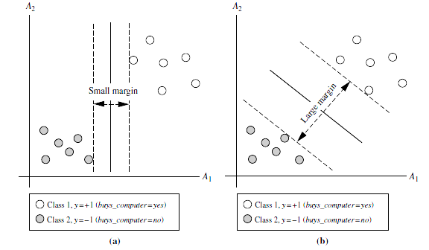
SVM- Linearly Separable Data
Finding Maximal Marginal Hyper plane
Small Margin
Large Margin
Support Vectors

Slide 64
SVM- Linearly Separable Data
It searches for the linear optimal separating hyper plane (i.e., “decision boundary”)
W.X + b = 0 where W is the weight vector and b is scalar value referred to as bias
If the training tuples are two dim we can rewrite the separating hyper plane as w₀ + w₁x₁ + w₂x₂ = 0
The hyper planes with largest margin are selected.
H₀ : w₀ + w₁x₁ + w₂x₂ >= 1 for class label y_{i} = +1
H₁ : w₀ + w₁x₁ + w₂x₂ <= -1 for class label y_{i} = -1
SVM finds this hyper plane using support vectors (“essential” training tuples) and margins (defined by the support vectors)

Slide 65
SVM- Linearly Separable Data

Slide 66
To find the functional margin
Functional Margin
Finding the margin of the hyperplane by comparing the classifier's prediction (w^{T}x+b) to the actual class (yi)
Distance of the point m(x_{i},y_{i}) from the decision boundary
Vector w (w1,w2) is normal to decision surface
Margin, γ^{i}, defines the scalar length from our data point to the decision boundary
Smallest functional margin of all points is the functional margin of the classifier

Slide 67
To find the functional margin

Slide 68
SVM – Nonlinear cases

Slide 69
SVM – Nonlinear cases

Slide 70
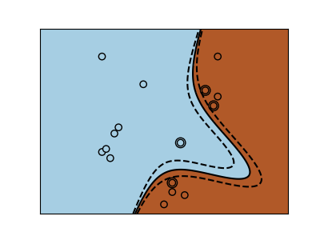
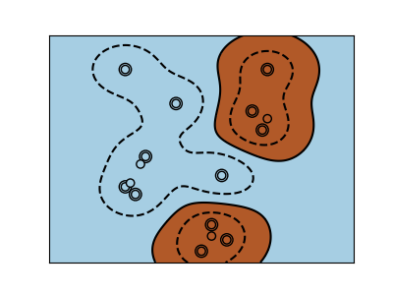
SVM- Nonlinear cases- Kernels
Polynomial Kernel
Radial Basis

Slide 71
Tuning Hyperparameters
Kernel:
linear, polynomial, and radial basis function (RBF).
Polynomial and RBF are useful for non-linear hyperplane.
Polynomial and RBF kernels compute the separation line in the higher dimension.
Regularization:
C is the penalty parameter, which represents misclassification or error term.
controls the trade-off between decision boundary and misclassification term.
A smaller value of C creates a small-margin hyperplane and a larger value of C creates a larger-margin hyperplane.
Gamma:
A lower value of Gamma will loosely fit the training dataset, whereas a higher value of gamma will exactly fit the training dataset, which causes over-fitting.
low value of gamma considers only nearby points in calculating the separation line,
the high value of gamma considers all the data points in the calculation of the separation line.

Slide 72
References
Kevin P. Murphy, Machine Learning: A Probabilistic Perspective, MIT Press, 2012.
Machine Learning by Andrew N G ( Chapter 6)
https://www.youtube.com/watch?v=-la3q9d7AKQ

